Slide 1
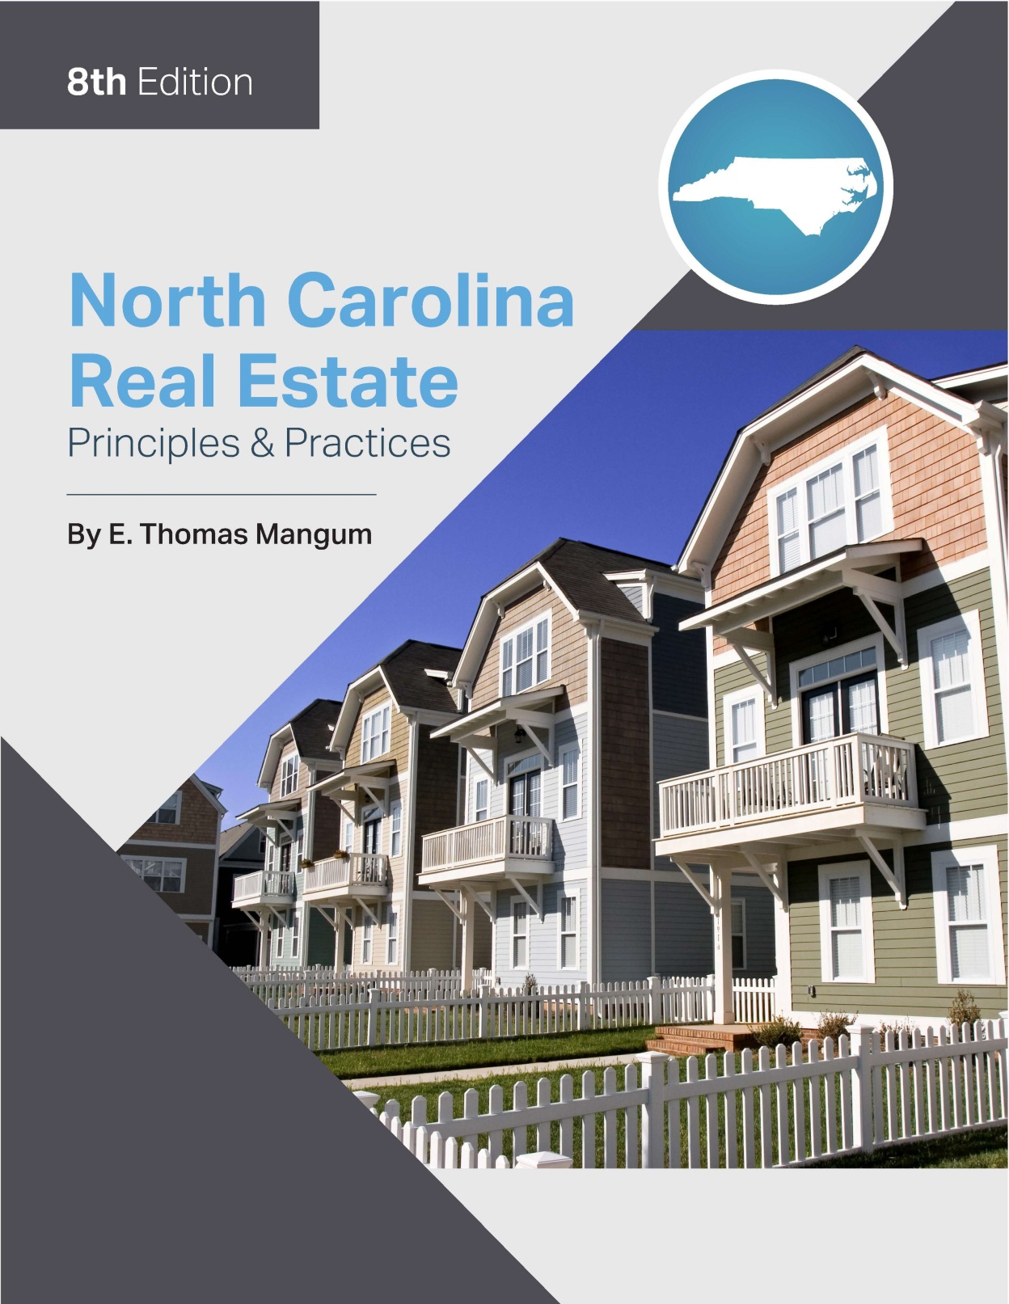

Slide 2
Chapter 1
Basic Real Estate Concepts
Learning Objectives
Describe the characteristics of real estate, including classes of property, physical characteristics of land, and economic characteristics of land.
Describe the concepts of land use and investment, including highest and best use, land use control, investment objectives, scope of the real estate business, and the real estate market.

Slide 3
Chapter 1
Basic Real Estate Concepts
Basic Terminology and Definitions
Classes of property:
Personal
Real
Real Property:
includes land.
Land -surface of the earth, the area below surface to the center of earth, and area above surface to highest heavens plus all structures and improvements which are permanently attached.

Slide 4
Chapter 1
Basic Real Estate Concepts
Basic Terminology and Definitions
improvements—Anything used to better or “improve” the use of the land.
artificially attached items
real property and
not personal
appurtenance—Any right or privilege that is considered to “run with the land.”
rights and privileges may be “personal” in nature.
Consider sewer lines or municipal water.

Slide 5
Chapter 1
Basic Real Estate Concepts
Basic Terminology and Definitions
Real property also includes tenements and hereditaments:
tenements − include land as defined, plus all corporeal (tangible) and incorporeal (intangible) rights in land.
hereditaments − include all land and tenements which can be inherited.

Slide 6
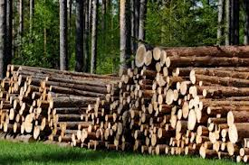
Chapter 1
Basic Real Estate Concepts
Personal Property – Anything not real property
Vehicles and boats
Jewelry, paintings
Mined minerals or harvested crops/timber
NOTE: Some items can be either real or personal property depending upon the circumstances. For example:
Which is real property and which is personal property?

Slide 7
Chapter 1
Basic Real Estate Concepts
Economic Characteristics of Land
Scarcity – There is a limited available supply of land.
Permanence of investment – the fixity of an investment in real estate in a given area makes it a permanent investment.
Location (Situs)- The 3-L’s of value

Slide 8
Chapter 1
Basic Real Estate Concepts
Physical Characteristics of Land
Immobility – Economic value through location.
Permanence – The physical permanence of land affects its long-term value.
Uniqueness (non-homogeneity) – Each property is unique.

Slide 9
Chapter 1
General Concepts of Land Use and Investment
The Highest and Best Use Concept
Provides greatest potential net return on investment.
Under-improvement or over-improvement diminishes highest & best use.
There is only one highest & best use at any given time for any given property.
The highest & best use of a specific property changes over time.

Slide 10
Chapter 1
General Concepts of Land Use and Investment
The Highest and Best Use Concept
Consider possible uses of a valuable piece of urban land:
parking lot (under improvement)
high rise apartment (zoning regulations on height)
maximum legal height of an office building (over improvement)
optimal height office building (highest and best use)

Slide 11
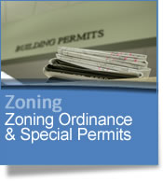
Chapter 1
General Concepts of Land Use and Investment
Public and Private Land Use Restrictions
Public land use controls
City planning & zoning
State & regional planning
Building codes
Occupancy requirements
Environmental requirements
Private land use controls
Restrictive covenants
Easements and other restrictions

Slide 12
Chapter 1
General Concepts of Land Use and Investment
Real Estate Investment Objectives
Personal use
Long-term appreciation
Tax shelter
Investment leverage
Positive cash flow
The emphasis for today's investor is usually either personal use or positive cash flow with appreciation. Historically, real estate investments were primarily used as tax shelters.

Slide 13
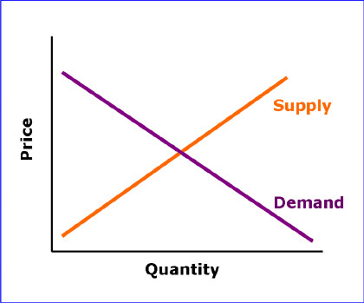
Chapter 1
Scope of the Real Estate Business
The Real Estate Market
The Free Market Concept
Buyers and sellers are free to negotiate and establish a price acceptable to both without undue pressure, urgency, or outside influence other than the principle of supply and demand.
Special Characteristics
The physical characteristic of immobility results in a market that is slow to react to changes in supply and demand.

Slide 14
Chapter 1
Scope of the Real Estate Business
The Real Estate Market
Supply and Demand
Many factors impact the value of property:
number of properties available in an area.
building production schedules
Cycles and Trends
Just as the economy is subject to peaks and valleys the real estate industry is also subject to recurring periods of recession and prosperity.

Slide 15
Chapter 1
Scope of the Real Estate Business
The Real Estate Practitioner
Important Note:
Broker or Agent is used interchangeably in the text when NO differentiation is needed
Broker and Provisional Broker are used to distinguish two categories of license.

Slide 16
Chapter 1
Scope of the Real Estate Business
The Real Estate Practitioner
North Carolina defines only one Real Estate license category, that of Broker. All must be licensed.
Provisional Broker – category of license that indicates person has not completed the post-licensing requirements and has restricted work
Broker – category of license that indicates person has either completed post-licensing requirements or received license prior to April 1, 2006
Broker-in-Charge (BIC) – has completed the educational and experience requirement necessary to supervise real estate agents

Slide 17
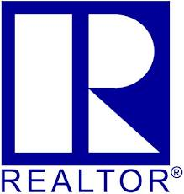
Chapter 1
Scope of the Real Estate Business
The Real Estate Practitioner
The Practitioner IS an advisor- a representative of his or her principal, whether buyer or seller.
The Practitioner is NOT a legal counselor or high pressure salesperson.

Slide 18
Chapter 1
Scope of the Real Estate Business
In order to ensure professional services to the client, The Real Estate Practitioner should have a thorough knowledge of:
the listing contract.
the purchase offer.

