Slide 1
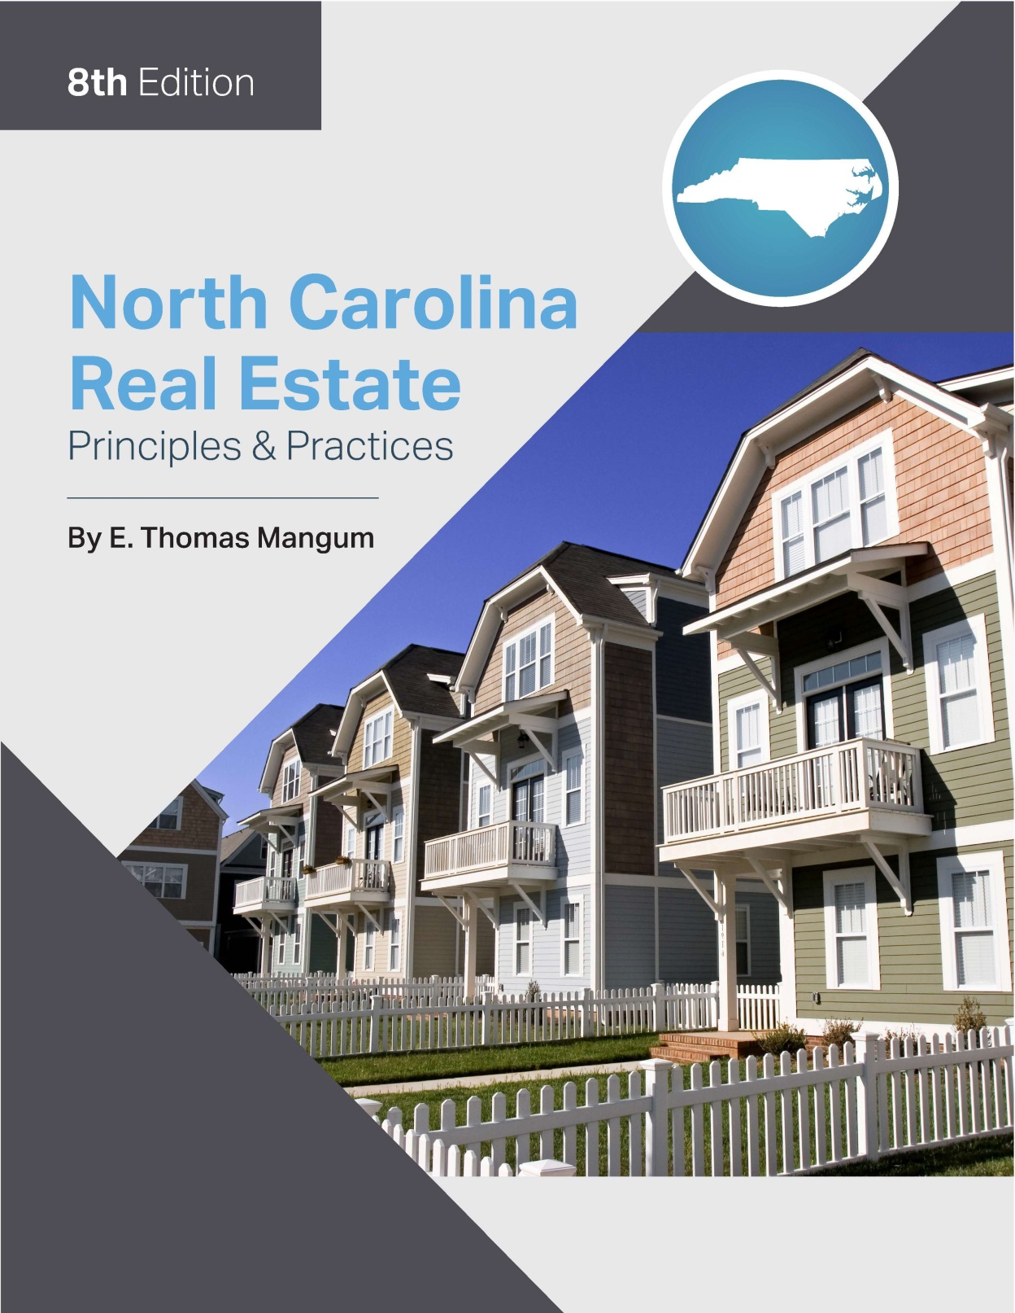

Slide 2
Chapter 10
Sales Contracts and Related Procedures
Learning Objectives
Describe the essential and common provisions of the NCAR/NCBA Offer to Purchase and Contract form 2-T
Describe the rights and obligations of the parties to a purchase contract
Understand the due diligence process including the rights and fees of the parties
Describe the characteristics and requirements of the offer
Describe the characteristics and requirements of the counteroffer
Describe the requirements for handling earnest money
Understand the installment land contract (contract for deed) provisions, advantages, and disadvantages
Understand the option to purchase and it’s requirements
Understand the different “preemptive rights” to a contract

Slide 3
Chapter 10
Sales Contracts and Related Procedures
“Drafting” Sales Contracts
Real estate brokers are allowed to fill in blanks of contract form or purchase offer form. Forms must have been designed by attorney.
Broker is not allowed to rewrite or alter basic text.
The broker will still be held responsible for proper completion of the blanks.

Slide 4
Chapter 10
Sales Contracts and Related Procedures
Importance of Appropriate Sales Contract Form (Including Sources)
Form used should be appropriate to broker’s type of transaction
The North Carolina Real Estate Commission (NCREC) cannot require the parties to use any particular form
NCREC requires any pre-printed form provided for use by a broker to contain 19 specific elements:
Cannot insert provision concerning payment or forfeiture of a commission
Cannot insert provision attempting to disclaim liability of a broker
These restrictions apply only to pre-printed forms proposed for use by broker
Nothing prohibits parties from producing their own forms

Slide 5
Chapter 10
Sales Contracts and Related Procedures
The Offer to Purchase and Contract (Standard Form 2-T)
widely used industry form for sale of residential properties
not appropriate for the sale of vacant lots/land, commercial properties, options, installment sales contracts (contract for deed), or more complex transactions
Refer to pages 278 through 290 for a summary of the NREC/NCBA Offer to Purchase and Contract form 2-T

Slide 6
Chapter 10
Sales Contracts and Related Procedures
Commonly Used Standard Addenda Forms
Back-up contract addendum (2A1-T):
Used when property is already under contract
The back-up buyer has binding contract to purchase the property only if existing primary contract is terminated.
Back-up buyer has right to terminate at any time prior to being notified of primary contract falling through.
If back-up buyer terminates he/she is entitled to refund of earnest money deposit (EMD)

Slide 7
Chapter 10
Sales Contracts and Related Procedures
Commonly Used Standard Addenda Forms
Contingent Sale Addendum (2A2-T):
used when buyers have to sell a property before they can purchase
buyer must have existing property under contract before due diligence date in the contract of the house he is purchasing:
earnest money deposit can be returned if:
buyers house is under contract but has not been purchased by settlement date for new house.
Buyer does not have a signed contract for house he is selling by due diligence date

Slide 8
Chapter 10
Sales Contracts and Related Procedures
Commonly Used Standard Addenda Forms
FHA/VA Financing Addendum (2A4-T):
Required when buyer is seeking FHA/VA financing
Stipulates that buyer can terminate contract if property does not appraise and obtain refund of EMD
This is true even if due diligence date is passed
Buyer Possession Before Closing Agreement Addendum (2A7-T):
Not a replacement for a lease agreement
Should not be used for possession for more than 14 days.
Seller Possession After Closing Agreement Addendum (2A8-T):
Serves the same purpose as the prior form

Slide 9
Chapter 10
Sales Contracts and Related Procedures
Commonly Used Standard Addenda Forms
Lead-based Paint or Lead-based Paint Hazard Addendum (2A9-T):
Must be given prior to first offer in the sale of pre-1978 houses
Addresses if seller has knowledge or records pertaining to lead-based paint
Gives buyer a 10-day period to conduct an assessment
Acknowledges seller has provided buyer with EPA pamphlet
Additional Provisions Addendum (2A11-T):
Expiration of offer by certain date/time
Improvement Permit for septic system
Rental and investment properties details
Repairs or improvement to be completed prior to the closing

Slide 10
Chapter 10
Sales Contracts and Related Procedures
Commonly Used Standard Addenda Forms
Vacation Rental Addendum (2A13-T):
Used for any vacation rental property subject to North Carolina Vacation Rental Act
Short Sale Addendum (2A14-T):
Used in cases where sale does not produce enough money to pay off existing mortgage and seller is unable or unwilling to pay difference
Makes the contract contingent upon short sale approval even if after the due diligence date
Stipulates any additional offers that appear must be presented to the lienholder by North Carolina law

Slide 11
Chapter 10
Sales Contracts and Related Procedures
Form for Sale/Purchase of Vacant Lot/Land (2A12-T)
Used only for the sale of vacant lots or land with no relevant structure.
Designed just like the standard offer to purchase but does not include fixtures, personal property, or other items related to a physical structure.

Slide 12
Chapter 10
Sales Contracts and Related Procedures
Sales Contract Procedures
Offer and Acceptance
The offeror is the party making the offer.
The offeree is the party receiving the offer.
In a counteroffer the roles of the offeror and offeree reverse.
Both the offer and acceptance must be in writing in order to be enforceable according to the Statue of Frauds.
There is no such thing as a binding offer.
An offer is not considered revoked until proper notice is considered delivered to the offeree or his/her agent.

Slide 13
Chapter 10
Sales Contracts and Related Procedures
Sales Contract Procedures
Offer and Acceptance
Acceptance must be identical with the terms of the offer.
Offers must be accepted in writing by all parties.
Until acceptance is communicated to the offeror there is no acceptance even if there is an oral statement of intent to sign.
Acceptance must comply with any reasonable requirement or restriction mandated by the offeror.

Slide 14
Chapter 10
Sales Contracts and Related Procedures
Sales Contract Procedures
Offer and Acceptance:
Communication of an offer should be promptly delivered as offeror retains right of revocation prior to proper notice of acceptance
Communication of the acceptance can be delivered by:
Oral communication
Visual communication
Mailbox rule – effective when mailed
Electronic communication

Slide 15
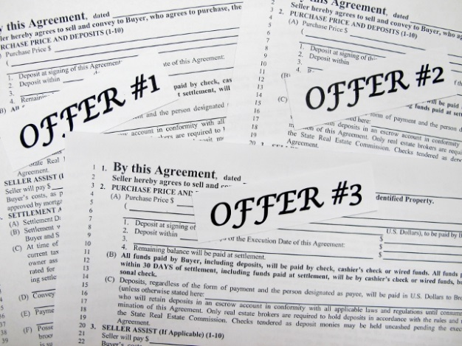
Chapter 10
Sales Contracts and Related Procedures
Sale Contract Procedures
Submitting Offers to Sellers:
Every broker is legally and duty bound to submit all offers to the seller:
Immediately but in no case later than 5 days
Brokers are not permitted to either accept or reject offers for the client
Multiple offers must be presented at the same time:

Slide 16
Chapter 10
Sales Contracts and Related Procedures
Handling Contract Modifications and Counteroffers
Modifications - changes to an existing binding contract
Counteroffers - changes where there has been no acceptance of an offer
Two primary methods of handling counteroffers:
Create a new (clean) offer.
Strike out original terms and insert new terms in their place:
All changes should be initialed and dated.
Only one set of modifications should be included on the form.
If subsequent changes are proposed, it is a good business practice to create a new form in order to be legible.

Slide 17
Chapter 10
Sales Contracts and Related Procedures
Electronically Submitted Offer and Acceptance
Submitting offers and acceptance by fax or email is the norm for most transactions.
Federal e-sign legislation and North Carolina’s Uniform Electronic Transaction Act allows electronic transaction to comply with Statue of Frauds.

Slide 18
Chapter 10
Sales Contracts and Related Procedures
Handling Earnest Money and Due Diligence Fee
Both fees are “good faith” monies
Due diligence fee:
non-refundable unless there is a breach of contract by the seller
for the time period between the formation of the contract and the due diligence date
check should be paid directly to the seller and not placed in agent’s escrow account unless received as cash

Slide 19
Chapter 10
Sales Contracts and Related Procedures
Handling Earnest Money and Due Diligence Fee
Two main ways the agent will see earnest money deposits (EMD):
paid at time of the offer, or within 5 days of the Effective Date of the contract whichever is indicated
Initial EMD can be paid in the form of cash, personal check, official bank check, or wire transfer
(Additional) EMDs are required to be in the form of immediately available funds and personal checks are not permitted

Slide 20
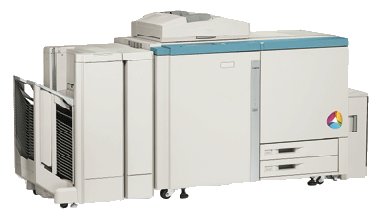
Chapter 10
Sales Contracts and Related Procedures
Furnishing Copies of Offers and Contracts to Buyer and Seller
Only one copy is required to create a binding contract.
It is common practice to have multiple copies to provide for all parties.
NCREC only requires a copy to be provided to the buyer and seller
Brokers are required to keep all instruments on file for at least 3 years

Slide 21
Chapter 10
Sales Contracts and Related Procedures
Installment Land Contracts
Contract to convey title and finance agreement in one.
Often used if financing is difficult to get.
Equitable Title – legal title conveyed once the terms of the agreement have been completed
Legal Title – interest held by the party who owns the real property:
Seller retains legal title until buyer has repaid the loan in full
North Carolina law requires 17 provisions to appear in the installment land contract
Seller required to record a copy of the contract or a “Memorandum of a Contract for Deed” within 5 days.

Slide 22
Chapter 10
Sales Contracts and Related Procedures
Installment Land Contracts- Advantages and Disadvantages
Advantages to Buyer:
Used when buyer has no alternative to obtain financing
Buyer can claim normal tax advantage on payment of property tax.
Disadvantages to Buyer:
penalties for default are severe
If seller defaults on his mortgage, buyer could lose his property.
The buyer does not have the usual protections of the deed of trust.

Slide 23
Chapter 10
Sales Contracts and Related Procedures
Installment Land Contracts- Advantages and Disadvantages
Advantages to Seller:
retains legal title to the property and if the buyer should default, foreclosure will not be required.
seller may be able to sell a property when the buyer had no real alternative way to finance the transaction.
Disadvantages to Seller:
In the event of default, the seller will still incur a time delay and the considerable legal expense to have the contract declared to be forfeited, thereby terminating the buyer’s contractual interest.

Slide 24
Chapter 10
Sales Contracts and Related Procedures
Option to Purchase Real Estate
It is an agreement that allows the optionee to tie up a piece of property but not be obligated to purchase it.
Optionor – the seller, who conveys option rights to the buyer
Optionee – the purchaser, who receives the option rights
Must be in writing under the Statue of Frauds and should be recorded under the Conner Act.
There are no standard pre-printed contract option forms as these should only be prepared by an attorney

Slide 25
Chapter 10
Sales Contracts and Related Procedures
Agreements for Preemptive Rights
rights that give the buyer/tenant the first right to either purchase or lease a property
Two types of preemptive rights:
Right of first refusal:
should the owner decide to sell, or lease, he will offer it to the named party first
does not require the seller to sell if the buyer decides to buy
2. Right of first opportunity to purchase:
Owner agrees to give lease the first chance to purchase the property at a price determined in the future if/when the owner decides to sell.
Common in commercial lease transactions.

