Slide 1
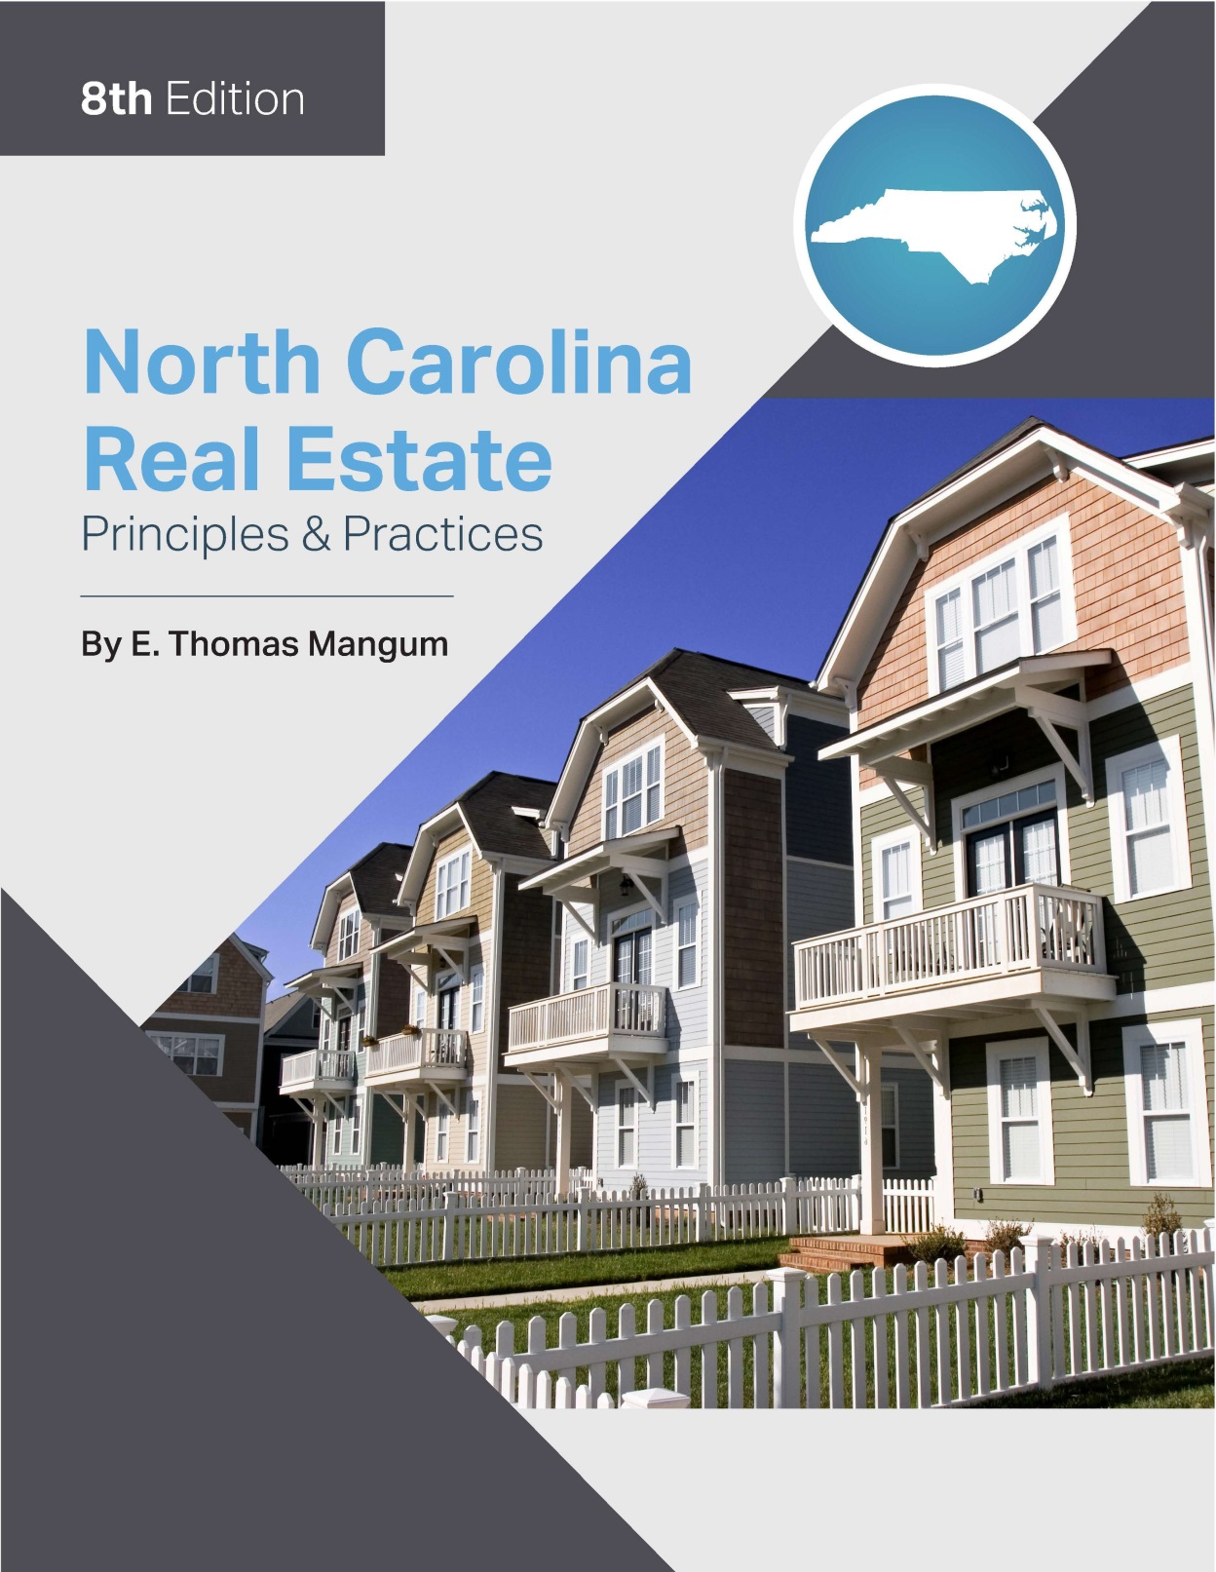

Slide 2
Chapter 12
Closing a Sales Transaction
Learning Objectives
List the preliminaries to closing
List the items required at closing
Describe the process of the closing meeting
Describe the placement of items ad debits and credits on the closing statement
Describe the provisions of the Real Estate Settlement Procedures Act (RESPA)
Calculate the balance due from the buyer or due to the seller in a closing statement

Slide 3
Chapter 12
Closing a Sales Transaction
Preclosing Procedures
Settlement – the preparation and delivery of documents as well as collection of funds necessary to finalize the transaction
Closing – the multi-step process of undertaking due diligence relative to the title, the preparation of documents, to the conveyance of the deed and the collection and disbursement of funds. The Offer to Purchase and Contract refers to closing as the point of recordation of the deed.

Slide 4
Chapter 12
Closing a Sales Transaction
Selecting and Providing Information to Closing Attorney
Usually it is the buyers responsibility to select.
Most lenders will require closing attorney to be from their “approved list”.
Buyer’s Due Diligence Process
Buyer can undertake due diligence prior to 5:00 p.m. of the “due diligence date” without risk of loss of earnest money deposit.
Buyer can undertake due diligence between due diligence date and closing but will lose earnest money deposit should he/she terminate.

Slide 5
Chapter 12
Closing a Sales Transaction
Preclosing Procedures
Buyer’s Due Diligence Process
Buyer’s loan
Appraisal
Property survey
Property insurance
Inspections
Septic/sewer system
Other Pre-Closing Matters

Slide 6
Chapter 12
Closing a Sales Transaction
Closing Procedures
Closing Methods and Procedures
Escrow method:
Buyers and sellers do not attend.
All paperwork done by escrow agent
Settlement Meeting method:
Most frequently used method in North Carolina
Procedures After the Settlement Meeting:
Title insurance company will review pertinent documents
Closing attorney cannot disburse funds until deed has been recorded
Funds must be “good and collected”
Closing attorney will report transaction to IRS on Form 1099-S

Slide 7
Chapter 12
Closing Procedures
Real Estate Settlement Procedures Act (RESPA)
Originally enacted in 1974 to provide assistance to buyers regarding obtaining a mortgage load for residential property.
Lender required to provide Good Faith Estimate (GFE) within 3 business days of loan application.
federally related mortgages
any mortgage loan made by an institutional lender that does not include owner financing and cash transactions

Slide 8
Chapter 12
Closing a Sales Transaction
Summary of RESPA Requirements
Loan Application
lender obtains borrower’s:
Name
monthly income
social security number- allows the credit report to be obtained
address of the property to be pledged as collateral
estimated value of the property
the requested loan amount.
Lender is required to provide borrowers (within three business days):
informational pamphlet “Know Before You Owe”
provides guidance on process of shopping for a house

Slide 9
Chapter 12
Closing a Sales Transaction
Summary of RESPA Requirements
Yield Spread Premiums- if mortgage is originated by a broker (not a lender) this must be disclosed to borrower as credit of fees paid for making loan at “above-market-rate”
CD- closing Disclosures for sellers and buyers
Amount of Reserves for escrow accounts
Disclosure of Loan Servicing- Will the loan be transferred?
Kickbacks for Referrals:
Kickbacks for closing related referrals are strictly prohibited.
Limited exception for “Controlled or Affiliated Business Arrangements”

Slide 10
Chapter 12
Closing a Sales Transaction
Summary of RESPA Requirements
Penalties for RESPA Violations
Criminal liability - fines up to $10,000 per violation
Civil liability
Licensing law

Slide 11
Chapter 12
Closing a Sales Transaction
Summary of RESPA Requirements
The Loan Estimate - (See Figure 12.3)
Provides an easy comparison of loan costs and terms.
Borrowers are required to be provided the LE within three business days of the loan application.

Slide 12
Chapter 12
Closing a Sales Transaction
Summary of RESPA Requirements
Permissible Variations
often called “tolerance limits”
No tolerance – fees totally within control of lender and cannot be altered prior to closing
10% tolerance – fees that cannot change more than 10% in aggregate
Unlimited tolerance – fees that can change by any amount without repercussions to lender

Slide 13
Chapter 12
Closing a Sales Transaction
Summary of RESPA Requirements
The Closing Disclosures
Two separate CD forms
Borrower/Buyer
Five pages: (see figure 12.2)
Seller
Two pages (see figure 12.1)
Lender is held responsible for accuracy of closing statements.
Substantial liability for accuracy

Slide 14
Chapter 12
Closing a Sales Transaction
Closing Statement (with LE (figure 12.3) and CD (figure 12.5) Worksheet)
The final accounting “worksheet” that indicates the receipts and expenses both the buyer and seller will incur along with totals showing amount owed by the buyer as well as amount due to the seller.
HUD-1 closing form must be used on residential 1-4 unit sales involving federally related mortgages.
In no circumstances should a licensee ever sign or otherwise agree with a closing statement that he/she believes to be in error or otherwise fraudulent.

Slide 15
Chapter 12
Closing a Sales Transaction
Settlement Statement Entries and Calculations
A closing statement is made up of a variety of entries called debits and credits:
Debit- amount, or charge, that a person pays.
Credit - amount, or charge that one receives
A closing statement is made up of single and double-entry items:
A single entry appears on only the buyer’s or seller’s side of the statement
a double entry appears on both the buyer’s and the seller’s sides.

Slide 16
Chapter 12
Closing a Sales Transaction
Settlement Statement Entries and Calculations
Primary entries that will appear on closing statements include:
Sales Price – Debit Buyer/Credit Seller
Earnest Money Deposit – Credit Buyer
Due Diligence Fee – Debit Seller/Credit Buyer
New First Mortgage Loan - Credit Buyer
Loan Payoff – Debit Seller
Loan Fees – Debit Buyer (unless otherwise agreed)
Attorney Fees - Debit Buyer
Title Insurance - Debit Buyer
Appraisal Fee - Debit Buyer (often POC)

Slide 17
Chapter 12
Closing a Sales Transaction
Settlement Statement Entries and Calculations
Credit Report - Debit Buyer (often POC)
Survey – Debit Buyer
Homeowner Insurance Policy – Debit Buyer
Deed Preparation – Debit Seller
Excise Tax – Debit Seller
Recording Fees – Debit to Responsible Party
Sales Commission – Debit Seller
Pre-Paid Interim Interest - Debit Buyer
Reserves and Escrows Required by Lender - Debit Buyer
Prorations – Varies
Other Fees

Slide 18
Chapter 12
Closing a Sales Transaction
Prorations and Prepaids
Basic Considerations
Who owes whom?
How much?
Day of closing is typically charged to the seller when prorating between seller and buyer
The state exam typically uses entries where “rounding off” is not an issue.
30-day Month/360 Year Method
every month treated equally regardless of days in month (i.e. February)
method used on the North Carolina real estate examination
365-Day Year/Actual Days in the Month Method

Slide 19
Chapter 12
Closing a Sales Transaction
Prorations and Prepaids
Traditional Proration Entries:
Real property taxes- important to determine properly
North Carolina taxes are due by September 1 but bills are sent out July 1.
Closing statement must reflect if:
Taxes have not yet been paid – taxes not yet payable
Taxes have not yet been paid – taxes payable (paid at closing)
Taxes have not yet been paid – taxes payable (to be paid at year end)
Taxes have already been paid by the seller

Slide 20
Chapter 12
Closing a Sales Transaction
Prorations and Prepaids
Traditional Proration Entries
Homeowner Association Fees
can be prorated annually, semi-annually, quarterly, or monthly
generally paid in advance
Rental Income
usually collected first of the month
generally paid in advance

Slide 21
Chapter 12
Closing a Sales Transaction
Prorations and Prepaids
Traditional Proration Entries
Mortgage Interest
generally calculated in arrears
due the first of the month
Interim interest – technically not a proration but has similar qualities to a proration
Loan assumption – seldom encountered

