Slide 1
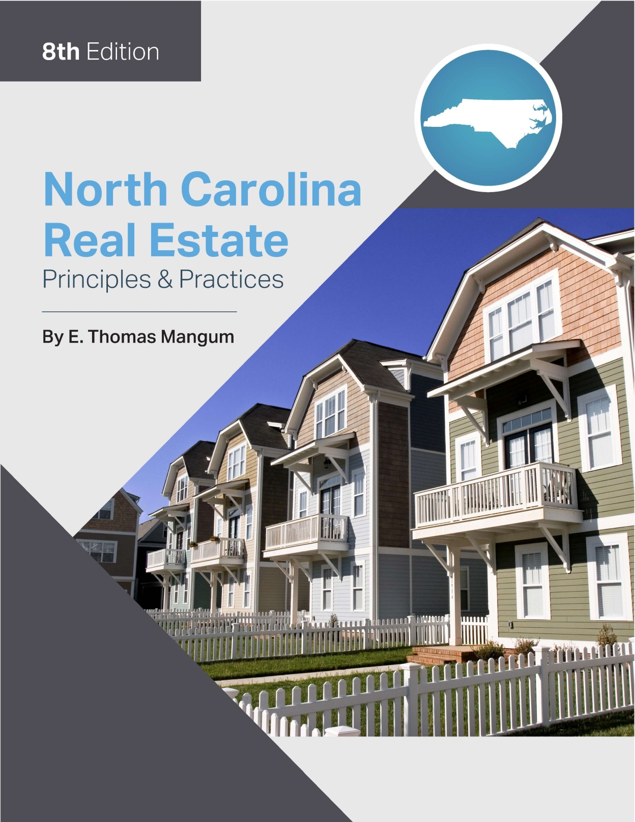

Slide 2
Chapter 20
Basic Real Estate Investment
Learning Objectives
Define equity, leverage, cash flow, and appreciation

Slide 3
Basic Real Estate Investment
Investing versus Speculation
Speculation
“flipping”
Purchasing property and quickly marketing it for higher price
Short term
Quick profit
speculative

Slide 4
Basic Real Estate Investment
Investing versus Speculation
Investing in Real Estate:
process of purchasing property and allowing revenue and profit to grow over time
leads to an increase in the value of the investment

Slide 5
Basic Real Estate Investment
Investing versus Speculation
Appreciation
Leverage
Cash flow
Liquidity

Slide 6
Chapter 20
Basic Real Estate Investment
Investing versus Speculation
Evaluation of a Potential Investment:
Return on Investment (ROI)
Capitalization Method:
The process of converting net operating income (NOI) into an indication of value (see Chapter 13)

Slide 7
Chapter 20
Basic Real Estate Investment
Basic Concepts
Cash flow
cash remaining after operating expenses and debt service obligations have been paid
All investments have cash flow but it is not always positive.

Slide 8
Basic Real Estate Investment
Basic Concepts
Equity
difference between what the property is worth and what is currently owed

Slide 9
Basic Real Estate Investment
Basic Concepts
Equity is created by three separate methods:
the ability to purchase a property for less than it is worth
the amount of the down payment, and
the gradual reduction of loan balance through amortization.

Slide 10
Basic Real Estate Investment
Basic Concepts
Leverage
Investor uses a smaller amount of his own money and borrows the majority of the purchase price from the mortgage lender.
Investor limits his own risk

Slide 11
Basic Real Estate Investment
Basic Concepts
Leverage:
Money borrowed means;
higher monthly mortgage
diminished cash flow

Slide 12
Basic Real Estate Investment
Basic Concepts
Leverage
During periods of low, or no revenues, and higher expenses, the highly leveraged investor will find himself in a very risky situation.

Slide 13
Chapter 20
Basic Real Estate Investment
Appreciation
increase in value of property
combination of inflation and market demand for a certain type, and location, of a property
not certain but a staple of real estate market

Slide 14
Basic Real Estate Investment
Tax-related benefits
The tax benefits of an investment property exceed those of the personal residence.
Investor has more “write offs”

Slide 15
Basic Real Estate Investment
Tax-related benefits
Investor can write off:
Property taxes
Mortgage interest
Operating expenses (repair and maintenance costs)
Utilities
Supplies

Slide 16
Basic Real Estate Investment
Tax-related benefits
Investor can also write off:
Mileage
Management gees
Professional fees
Depreciation
Any other reasonable expenses for efficient operation of investment

