Slide 1
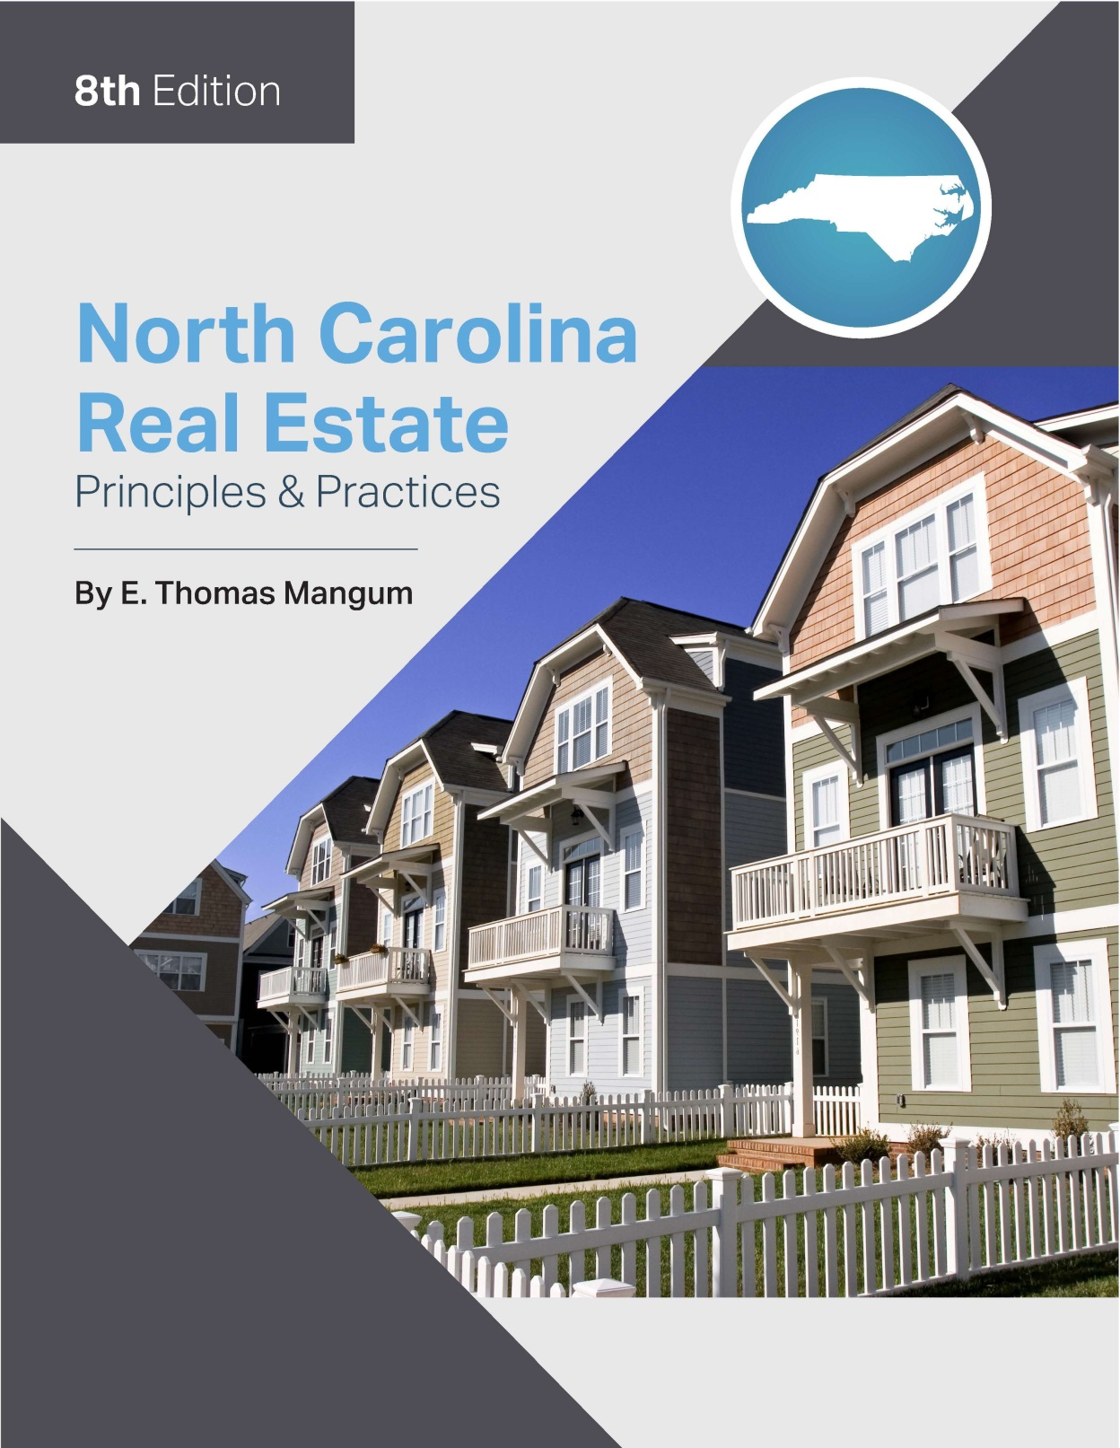

Slide 2
Chapter 17
Fair Housing
Learning Objectives
Describe the provisions of the Federal Fair Housing Act of 1968 as amended in 1988, including the criteria upon which discrimination is prohibited, definitions of terminology, exemptions, and provisions for enforcement
Describe the provisions of the North Carolina Fair Housing Act of 1983, including unlawful discriminatory practices, exemptions, enforcement, and penalties
Describe the provisions of the Civil Rights Act of 1866, including prohibitions and enforcement

Slide 3
Chapter 17
Fair Housing
Federal Fair Housing Act
Prohibits discrimination in housing on the basis of race, color, religion, sex, national origin, handicap, and familial status.
Definitions:
Dwelling:
Any building, structure, or portion thereof which is occupied as, or designed or intended for occupancy as, a residence by one or more families.
Includes any vacant land which is offered for sale or lease for the construction or location thereon of any such building, structure or portion thereof.

Slide 4
Chapter 17
Fair Housing
Federal Fair Housing Act
Elderly housing:
Housing in which 80% of the units are occupied by at least one person aged 55 or older
Familial status:
Includes children under age 18, pregnant women, or persons with, or in the process of obtaining, custody of children
Handicap:
Any physical or mental impairment that limits one or more of the essential functions of life

Slide 5
Chapter 17
Fair Housing
Federal Fair Housing Act
Person:
Includes one or more individuals, corporations, partnerships, associations, labor organizations, legal representatives, mutual companies, joint stock companies, trusts, unincorporated organizations, trustees, trustees in bankruptcy, receivers, and fiduciaries.
To rent:
Includes to rent, to sublease, to let, and otherwise to grant for a consideration the right to occupy premises not owned by the occupant.

Slide 6
Chapter 17
Fair Housing
Federal Fair Housing
Blockbusting:
Induce or attempt to induce any person to sell or rent any dwelling for profit by representations regarding the entry or prospective entry into the neighborhood of a person or persons of a particular race, color, religion, sex, national origin, handicap, or familial status
Steering:
Directing of prospective purchasers or tenants, especially minority purchasers or tenants, toward or away from specific neighborhoods because they belong to a protected class under the Fair Housing Act.

Slide 7
Chapter 17
Fair Housing
Federal Fair Housing Act
Illegal advertising:
Making, printing, or publishing any notice, statement, or advertisement, with respect to the sale or rental of a dwelling that indicates any preference, limitation, or discrimination based on race, color, religion, sex, national origin, handicap, or familial status, or an intention to make any such preference, limitation, or discrimination.

Slide 8
Chapter 17
Fair Housing
Federal Fair Housing Act
Illegal financing, redlining:
Violations of the Fair Housing Act by lending institutions
Exemptions:
The FFHA allows exemptions under some circumstances. These exemptions are not allowed if:
Discriminatory advertising has been used.
The services of a real estate licensee or the services of any person in the business of selling or renting dwellings are used.
North Carolina licensing provisions prohibit licensees from discriminatory practices in their personal dealings, even when they are acting for themselves and not as an agent for others.

Slide 9
Chapter 17
Fair Housing
Federal Fair Housing Act
Exemptions
In the absence of the preceding limitations, exemptions are available if:
An owner does not own more than three single-family dwellings at one time
Only one exemption in any 24-month period

Slide 10
Chapter 17
Fair Housing
Exemptions
An owner of an apartment building containing not more than four apartments is exempt in the rental of the apartments, provided the OWNER occupies one of the apartments as a personal residence.
Religious organizations or private clubs who operate properties for members:
not for commercial purposes
membership in organization is not restricted on account of of race, color, sex, national origin, handicap, or familial status.

Slide 11
Chapter 17
Fair Housing
Exemptions
In certain cases involving housing for the elderly, there is limited exemption permitting discrimination based on familial status

Slide 12
Chapter 17
Fair Housing
Enforcement
The Federal Fair Housing Act is enforced in three ways:
Administrative procedure through the Office of Equal Opportunity of the Department of Housing and Urban Development (HUD)
Can act on its own information and initiative.
Must act in response to complaints filed up to one year after alleged discrimination.
Complaints made to HUD are referred to the North Carolina Human Relations Commission.
Fines of $10,000, $25,000, or $50,000 can be imposed by the Commission for frequent or numerous infractions.

Slide 13
Chapter 17
Fair Housing
Enforcement
By Civil Suit:
Can be brought by the aggrieved party in a federal district court within two years of the alleged violation of the Act.
The Department of Justice:
Can file a civil suit in any appropriate U.S. District Court where the Attorney General has reasonable cause to believe that any person or group is engaged in a pattern of violation of the Act and, as such, raises an issue of general public importance.

Slide 14
Chapter 17
Fair Housing
North Carolina Fair Housing Act
Unlawful Discrimination:
The North Carolina Fair Housing Act of 1983 is similar to the Federal Fair Housing Act of 1968.
Prohibitions virtually identical to those of the federal act.
Exemptions:
no exemption for private owner
home owner may not turn away minority applicant
for the rental of rooms in a home occupied by the owner
for owner of a rental unit of four families or fewer if the OWNER OR OWNER’S FAMILY occupy one unit

Slide 15
Chapter 17
Fair Housing
North Carolina Fair Housing Act
Enforcement and penalties:
North Carolina Human Relations Commission enforces both state and federal act.
Complaints filed with the N.C. Human Relations Commission (or equivalent enforcement agency). Agency must:
investigate the complaint.
try negotiation and persuasion to mitigate.
If not solved, must either initiate a lawsuit in state court or advise aggrieved party of his right to start a private lawsuit.
Aggrieved individual can sue even if commission does not find merit in the case.

Slide 16
Chapter 17
Fair Housing
Federal Civil Rights Act of 1866
In 1968, the U.S. Supreme Court applied the Civil Rights Act of 1866 to prohibit racially based discrimination in housing, notwithstanding the exemptions written into the Fair Housing Act of 1968.
This means that any discrimination on the basis of race is strictly prohibited, regardless of exemptions present in other Acts.
This Act may be enforced by private law suit in federal court.

Slide 17
Chapter 17
Fair Housing
Additional Regulation of Fair Housing in North Carolina
The North Carolina Real Estate Commission prohibits licensees from engaging in discriminatory practices in their personal transactions.
The following provision must be included in all written agency contracts, highlighted, as in boldfaced type:
THE AGENT (FIRM) SHALL CONDUCT ALL BROKERAGE ACTIVITIES IN REGARD TO THIS AGREEMENT WITHOUT RESPECT TO THE RACE, COLOR, RELIGION, SEX, NATIONAL ORIGIN, HANDICAP OR FAMILIAL STAUS OF ANY PARTY OR PROSPECTIVE PARTY TO THE AGREEMENT

Slide 18
Chapter 17
Fair Housing
Equal Housing Opportunity Today
A recent study by HUD showed the minorities are still confronted by discrimination
48% chance of encountering discrimination in the purchase of a home
72% chance in leasing a rental unit

Slide 19
Chapter 17
Fair Housing
Americans with Disabilities Act (ADA)
Disability:
a physical or mental impairment that substantially limits one or more of the major life activities of a person
Cannot be denied access to public transportation, any commercial facility, or public accommodation.
ADA applies to:
owners and operators of public accommodations and commercial facilities
all local and state governments.

Slide 20
Chapter 17
Fair Housing
Sexual Harassment
It is a violation of North Carolina law for a lessor or his agent to sexually harass a tenant or prospective tenant.
The landlord and his agent are prohibited from making unsolicited overt requests for sexual acts when submission to such conduct is a term of the execution or continuation of a lease or the according of tenant’s rights under the lease.

