Slide 1
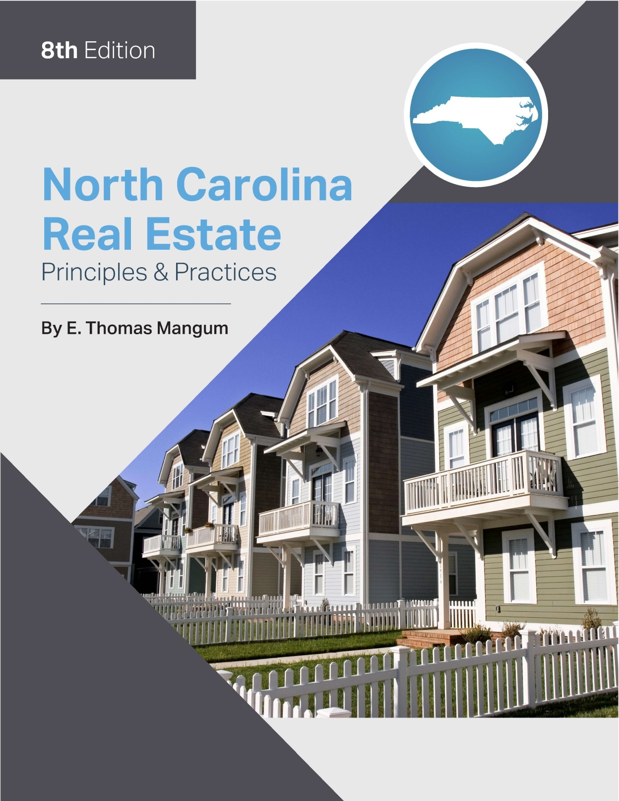

Slide 2
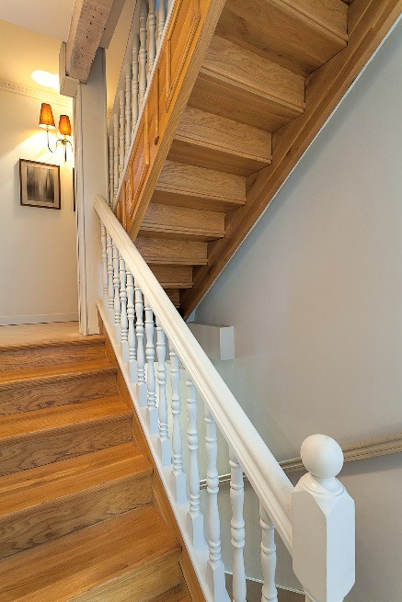
Chapter 18
Federal Taxation of Home Ownership/Sale
Learning Objectives
Define and list examples of income tax deduction benefits of home ownership
Define, and be able to calculate, basis, adjusted basis, amount realized, and gain realized in the sale of a personal residence

Slide 3
Chapter 18
Federal Taxation of Home Ownership/Sale
Tax Deductions for Homeowners
Two tax-deductible expenses
1. real property taxes paid to the local taxing authority
mortgage interest (not principal).
discount points for obtaining a purchase or refinance loan
allowable deductions provide greater tax relief than standard deduction

Slide 4
Federal Taxation of Home Ownership/Sale
Real Property Taxes
Taxes on real property:
deductible in the year taxes are paid to taxing authority
Assessments:
not deductible
may be itemized as additions to basis
basis- original cost of property plus material improvements that add value
helps reduce taxes when property is sold

Slide 5
Chapter 18
Federal Taxation of Home Ownership/Sale
Mortgage Interest
Often a major advantage of home ownership
Savings depend on:
Amount of interest paid
Taxpayer’s income bracket
Amount of the minimum standard deduction
Number of itemized deductions the taxpayer claims

Slide 6
Federal Taxation of Home Ownership/Sale
Mortgage Interest
Lower mortgage interest rates and higher minimum standard deductions:
reduced or eliminated some tax savings for those with:
lower incomes
small to moderate mortgage interest payments

Slide 7
Chapter 18
Federal Taxation of Home Ownership/Sale
Mortgage Interest
Deductible Interest
debt that generates “qualified residence interest”
must be secured by the property
Acquisition debt:
incurred in the purchase of a personal residence
interest generated on the first $1,000,000 is deductible

Slide 8
Federal Taxation of Home Ownership/Sale
Mortgage Interest
Deductible Interest
Equity debt
All debt secured by the residence
Can not exceed the fair market value of the residence reduced by the acquisition debt.
The interest generated by the first $100,000 is deductible.

Slide 9
Chapter 18
Federal Taxation of Home Ownership/Sale
Sale of a Personal Residence Basis
Taxpayer determines if there will be any tax liability.
Any profit (capital gain)?
Any capital loss?
Capital Gains:
Profit from the sale of property
Long or short term
Short term gains:
Held for less than 12 months
Taxed at same rate as ordinary income

Slide 10
Federal Taxation of Home Ownership/Sale
Sale of a Personal Residence Basis
Long term gains:
Held for more than 12 months
Reduced tax rates (do not exceed 15%)
Capital Losses:
Losses on the sale of a home
not deductible on residences
Deductible on commercial property
Capital Improvement:
permanent items
Increase value of property

Slide 11
Chapter 18
Federal Taxation of Home Ownership/Sale
Sale of a Personal Residence Basis
Basis:
The amount originally paid for the property. Typically the purchase price
Adjusted Basis:
Original costs incurred as a result of purchasing and acquiring title to the property + cost of capital improvements
Amount Realized:
sales price minus allowable expenses of sale

Slide 12
Federal Taxation of Home Ownership/Sale
Sale of a Personal Residence Basis
Cost of Acquisition:
Allowable closing costs
Capital Gains
Amount Realized − Adjusted Basis = Capital Gain

Slide 13
Chapter 18
Federal Taxation of Home Ownership/Sale
Effect of Purchase and Sale
Expenses that may effect the taxable gain
Title Insurance Premium
Transfer Tax
Attorney’s Fees
Deed Preparation
Closing Costs
Discount Points
Loan Origination Fee
Other expense items such as surveys, recording, etc.
Commission
Fix-up Costs
Moving expenses
Financial Penalty

Slide 14
Federal Taxation of Home Ownership/Sale
Effect of Purchase and Sale
IMPORTANT TO REMEMBER
Cost of acquiring property
Paid by owner
Cost included in basis
Cost incurred in selling property
Deducted from gross sales

Slide 15
Chapter 18
Federal Taxation of Home Ownership/Sale
Rules for Taxation of Capital Gain
Capital gains for Personal residence:
$250,000 or less -excluded from taxation for single taxpayer
$500,000 for a married couple filing jointly
capital gain exceeds exemption amount, taxpayer(s) pay taxes on excess
seller(s) must own AND occupy the residence for any two of the previous five years
Reporting Features
Revenue Procedure 98-20:
Seller must provide closing agent with assurances before January 31 of the year immediately following the year the property is sold.

Slide 16
Federal Taxation of Home Ownership/Sale
Rules for Taxation of Capital Gain
Reporting Features
seller must certify:
that seller and spouse, have met ownership, occupancy, and use requirements for the exclusion;
that no part of the residence has been used for rental or business after May 6, 1997;
that gain does not exceed the limit of $250,000/$500,000,
The certification must include a separate assurance for each requirement.

Slide 17
Chapter 18
Federal Taxation of Home Ownership/Sale
Special Rules That May Apply to Some Residential Transaction
Installment Sales:
seller finances a portion of sales price and receives monies in two or more tax years
Like-Kind Exchanges: investment properties:
one sold and property being acquired must be held for productive use in a trade or business or held for investment.
Vacation Homes:
Owner must not live there more than 14 days/year or more than 10% of time rented.
Home Office:
space must be used exclusively for business.
Competent tax advice should be secured

