Slide 1
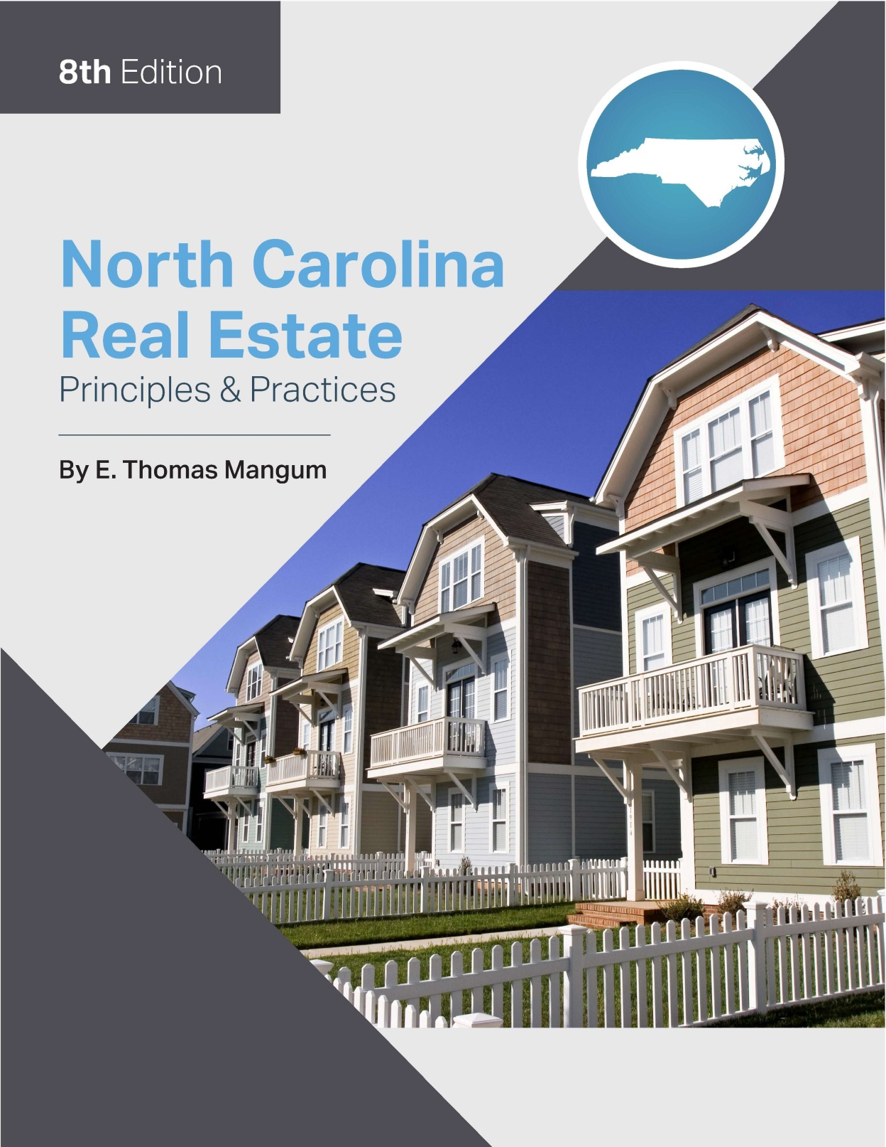

Slide 2
Chapter 2
Property Ownership and Interests
Learning Objectives
Define and give examples of real property and personal property
Define and give examples of fixtures, as well as describe tests for determining if an item is a fixture
Define and list the freehold estates
Define severalty and concurrent property ownership including condominiums, townhouses, cooperatives, PUD’s, and timeshare property
List and define types of liens
List and define types of easements
Define encroachments, water, air, and subsurface rights

Slide 3
Chapter 2
Property Ownership and Interests
The Concept of Property
Real Property
Land - anything meant to be permanent (fences, swimming pools, retaining walls).
Plants not requiring annual cultivation (fructus naturales), not in movable container
Tenements - can be touched and seen (buildings)
things that are intangible (easements).
Hereditaments are those things capable of being inherited.

Slide 4
Chapter 2
Property Ownership and Interests
Appurtenances:
rights or privileges that “run with the land”
cannot exist by themselves
include Riparian Rights (rights of an owner bordering a flowing body of water) and Littoral Rights (Rights of an owner whose property borders an ocean or lake)
Natural processes affect riparian boundaries:
Accretion - the boundary of riparian land is extended by natural forces.,
Reliction - permanent receding of the water that leaves the ground under it dry and exposed.
Erosion- the reverse of accretion.
Avulsion- rapid or sudden change in riparian land, resulting from violent natural forces.

Slide 5
Chapter 2
Property Ownership and Interests
Appurtenances
Air and Subsurface Rights
The owner may conduct mining operations.
The ownership of and the rights to the area above the surface of the earth (air rights)
Lateral and Subjacent Support
Lateral - Right of land to be supported in it’s natural state by adjacent land
Subjacent – Right to have land supported from below (i.e. mining)

Slide 6
Chapter 2
Property Ownership and Interests
Personal Property:
also called chattel or personalty
anything not considered real property
ownership is conveyed by a “Bill of Sale”

Slide 7
Chapter 2
Property Ownership and Interests
Personal Property
Fixtures- Item that was once personal property that has become real property by virtue of its’ attachment
Total circumstance test- determines fixture in absence of contract:
1. Intention – major determinant
2. Relation of the attacher- owner or renter?
3. Method of attachment- will removal cause damage?
4. Adaptation- example; window blinds
Trade fixtures – fixtures used in the conducting of commerce
considered personal property
Uniform Commercial Code – provides for a lender to have a fixture considered personal until paid off.

Slide 8
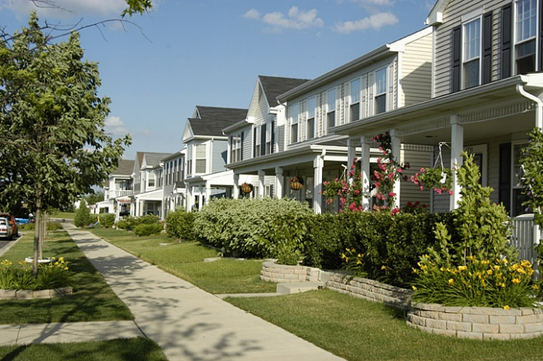
Chapter 2
Property Ownership and Interests
Personal Property
Improvements
anything attached that increases the value or utility of the land
can be “to the land” or “on the land”
“To the land” includes roads, utilities, grading, etc.
“On the land” includes buildings

Slide 9
Chapter 2
Property Ownership and Interests
Estates in Real Property
Definitions
Right of possession- The owner of an estate in land has the right of possession and the right to use it.
Right of use- An easement owner has the use of the land but not the right to possess it. (nonpossessory interest)

Slide 10
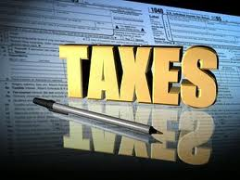
Chapter 2
Property Ownership and Interests
Estates in Real Property
Taxation
Real property tax is the largest source of income for local government.
Escheat
When an owner dies without leaving a valid will,
and no apparent heirs, the property will convey
(escheat) to the state.

Slide 11
Chapter 2
Estates in Real Property
Types of Estate in Land
Freehold Estate- ownership interest of at least a lifetime.
Estates of Inheritance
Fee Simple Absolute:
also known as “fee simple” or “fee”
the highest and best form of ownership available in real property
Fee Simple Determinable
Grantor sets conditions on future use of real property.
If some stated condition happens, the estate is terminated AUTOMATICALLY.

Slide 12
Chapter 2
Estates in Real Property
Estates of Inheritance
Fee Simple Subject to Condition Subsequent:
Grantor sets conditions on future use of the property in some way. “strings are attached”
Example- “This property can never be used as a landfill.”
Estate Pur Autre Vie:
Estate for the life of another
(i.e. Person A conveys title to Person B
for the lifetime of Person C)

Slide 13
Chapter 2
Estates in Real Property
Estates not of Inheritance
Life Estates
Estates of exactly lifetime duration
Not inheritable
Conventional Life Estate:
created by intention using conveyance
instrument (will or deed)
non inheritable, freehold estate
Marital Life Estate:
created by the operation of law
governs the distribution of property for a
spouse who dies intestate (without a will)

Slide 14
Chapter 2
Estates in Real Property
Estates not of Inheritance
Life Estates
Marital Life Estate
A will cannot defeat the marital interest of a surviving spouse.
Statute does not apply to property owned as tenants by the entirety.
Surviving spouse has a choice of EITHER:
Marital life estate
OR
Property of the deceased spouse willed to the surviving spouse.
Allows surviving spouse a life estate in 1/3 of real property owned in severalty by the deceased anytime during the marriage.

Slide 15
Chapter 2
Estates in Real Property
Life Estates
Rights of Life Tenants
Right of alienation- Life tenant may transfer his/her title to another.
Right of estovers:
Allows life tenant to cut and use a reasonable amount of timber from the land to repair buildings or to use as fuel.
Responsibilities of Life Tenants
Preservation- Must not commit waste
Taxes- Has an obligation to pay the real property taxes on the property in which he/she has a life estate.
Responsibility to repair- A duty to make repairs to the improvements on the land

Slide 16
Chapter 2
Estates not of inheritance
Non-Freehold Estates
Estate for Years:
For any fixed period of time
Automatically terminates at the end of that period
No notice required to terminate
Estate from Year to Year (periodic estate):
A periodic estate that automatically renews at the end of its period if the parties do not provide otherwise
Notice is required to terminate
Estate at Will:
An indefinite duration
May be terminated by either party by giving notice to the other party.
Payment of rent would change this to a periodic estate.
Estate at Sufferance:
A holdover situation created when the tenant’s lease has expired and he/she fails to vacate the premises.
Differs from trespassing in that tenant originally entered property legally.

Slide 17
Chapter 2
Ownership of Real Property
Ownership in Severalty:
Title is held in the name of only one person.
Concurrent (Joint) Ownership:
simultaneous ownership of real property by two or more people
Tenancy in Common:
two or more people holding title to property at the same time with no right of survivorship
Each tenant in common holds an undivided interest in the entire property.
These interests may be, but need not be equal.
Joint Tenancy:
must acquire interests at the same time and on same deed
no automatic right of survivorship in North Carolina
If joint tenant sells his/her share, the new owner will become a tenant in common.

Slide 18
Chapter 2
Ownership of Real Property
Concurrent Ownership:
Tenancy by the Entirety:
limited to ownership of husband and wife
right of survivorship
surviving spouse receives title by operation of law
Combination (Hybrid) Forms of Ownership:
Condominium
Ownership is the same as any freehold estate.
Includes ownership of the airspace of the individual unit as well as co-ownership in the common areas.
The 1986 North Carolina Condominium Act
Pertains primarily to residential condominiums
Public offering statement
Purchaser’s right to cancel
Escrow of deposit
Resale certificates
Warranties

Slide 19
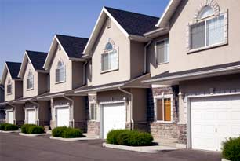
Chapter 2
Ownership of Real Property
Combination (Hybrid) Forms of Ownership:
Townhouse:
ownership of the unit as well as the specific portion of land upon which the individual unit is located
The Home Owner’s Association owns the common areas.
Cooperatives:
ownership of shares of stock in a corporation that owns
a building containing cooperative apartments
Right of possession is provided by a proprietary lease.

Slide 20
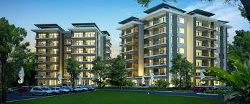
Chapter 2
Ownership of Real Property
Combination (Hybrid) Forms of Concurrent Ownership
Time Sharing:
any right to occupy a property for five or more separate time periods over a span of five or more years
five day right of rescission
escrow requirement ten days
Purchasers must be given a public offering statement.

Slide 21
Chapter 2
Ownership of Real Property
Encumbrances to Real Property
Liens
A lien is a claim or a charge against the property that can result from a contractual agreement or from the operation of law. Diminishes “Bundle of Rights.”
Specific Liens:
Mortgage:
A specific property is pledged as security for a debt.
North Carolina uses deed of trust as security instrument.
Default on repayment of the mortgage or deed of trust note will cause the lender to foreclose by having the property sold at public auction.
The proceeds of the sale are used to satisfy the debt.

Slide 22
Chapter 2
Encumbrances to Real Property
Specific Liens:
Real Property Tax:
levied by a local government
has priority over all other liens
good for ten years
Special Assessment Liens
Mechanic’s Liens (statutory liens)
lien filed by anyone who provides labor or material to a property
Must file within 120 DAYS from the last day that labor or material was furnished to the property.
Effective from the first day that labor or material was furnished to the property.
Must be enforced within 180 DAYS from the last day of work.

Slide 23
Chapter 2
Encumbrances to Real Property
Specific Liens:
Commercial Real Estate Broker Lien
Broker/Firm can file in order to protect rights to a commission.
General Liens
Judgment:
result from losing a lawsuit
may be recorded in any county in the state
Personal property tax:
licensed motor vehicles no longer in this category
Income tax:
for federal and state income taxes

Slide 24
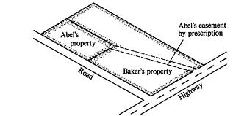
Chapter 2
Encumbrances to Real Property
Writ of Attachment:
pre-judgement right for creditors to make certain debts will be paid
Restrictive (Protective) Covenants:
limit the way land may be used
Lis Pendens:
notice of pending litigation
Easements:
Non-possessory interest
Two major groups:
Appurtenant- Something that has been added and “moves with the land”
In Gross- A personal privilege. Not dependent on ownership.

Slide 25
Chapter 2
Encumbrances to Real Property
Creation of Easements
Express (specifically stated or written)
Implied- actions rather than words establish the rights
Operation of Law- by prescription, condemnation (under eminent domain), or statutory cartway

Slide 26
Chapter 2
Encumbrances to Real Property
Termination of Easements
Easements may be terminated as follows:
release of the easement by the dominant owner to the servient owner
combining of lands - combining the dominant and servient properties into a single tract
abandonment of the easement by the dominant owner
failure of purpose- cessation of the purpose for which the easement was created
expiration of a specified time for which the easement was created

Slide 27
Chapter 2
Encumbrances to Real Property
Encroachments:
a trespass on the land of another as a result of an intrusion or invasion by some structure
as disclosed by a survey

